Slide 1
Laramie Peak WHMA
Fence conversion to Wildlife Friendly Standards

Slide 3
Laramie Peak WHMA Fence conversion
Old fence is currently woven wire and five strand with the top wire at 50-52 inches in places. The entire ranch has over 38 miles of different types of fence that restrict wildlife movement, and we have landowners willing to make some changes.
The conversion to wildlife friendly fences will enhance migration corridors and decrease fence related mortality for ungulates caused by old fences. The conversion will provide protection and enhancement of winter forage needed for big game and reduction of maintenance needs by moving the fences to locations away from snow load areas.

Slide 4
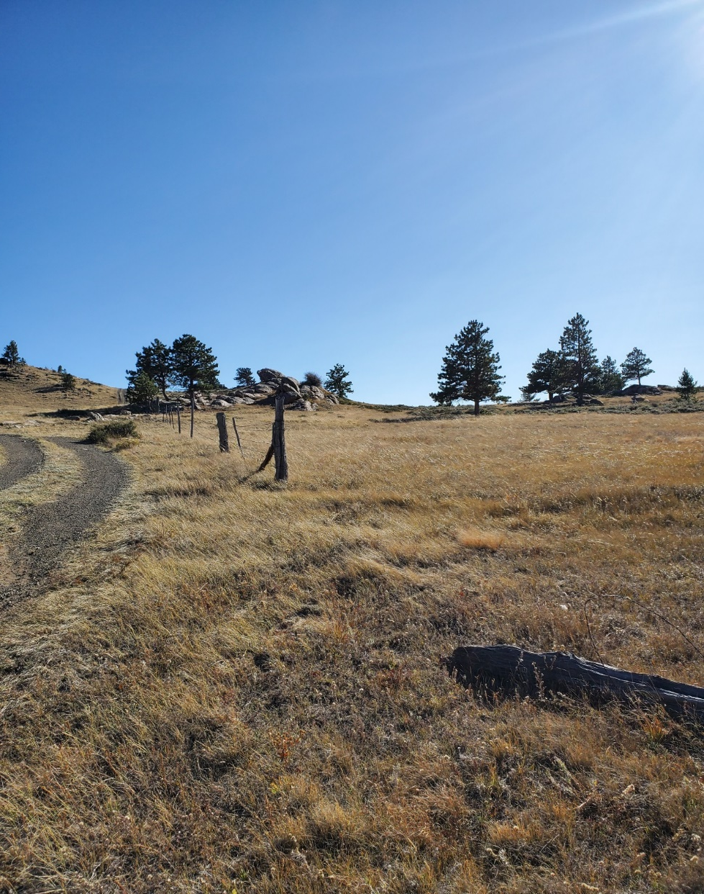
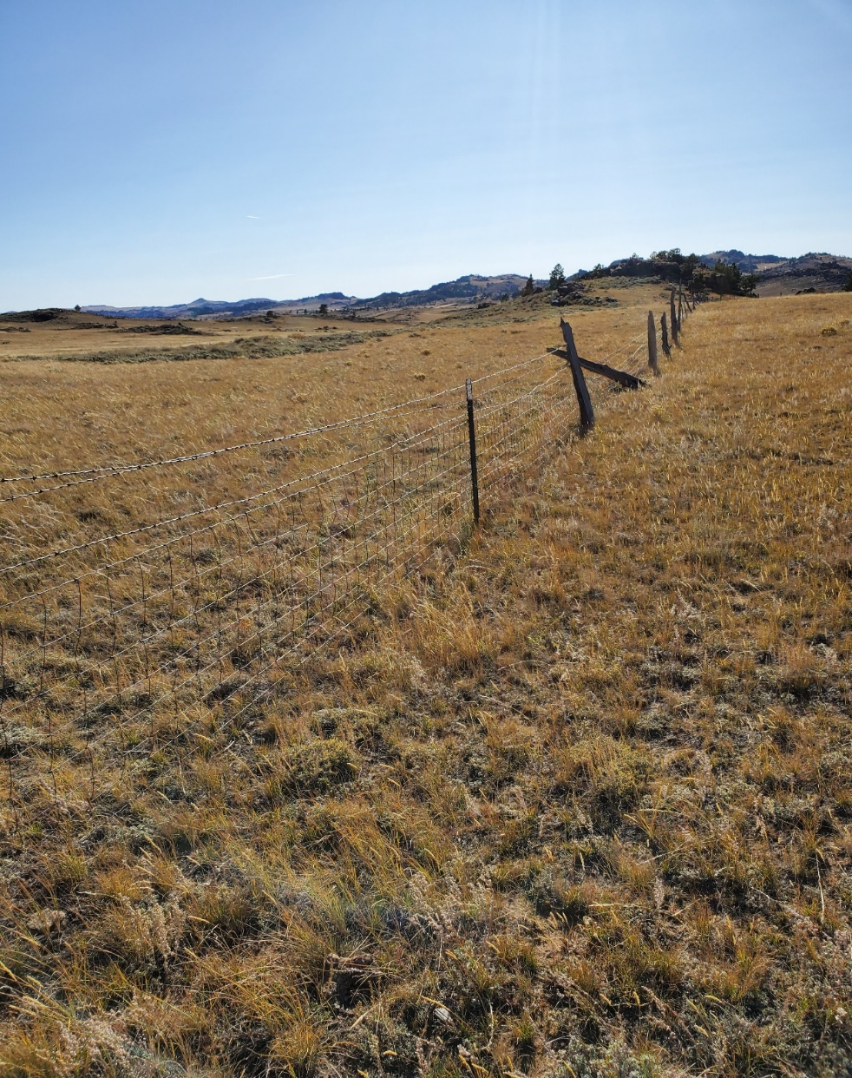
Current fence photos

Slide 5
Laramie Peak WHMA Fence conversion
Potential Partners include:
Vale Ranch LLC, Wild Sheep Foundation, Rocky Mountain Elk Foundation, Wyoming Wildlife Natural Resource Trust, Wyoming Game and Fish Trust, Wyoming Governors Big Game Coalition, and Wyoming Game and Fish Department.
Volunteer opportunities to assist in removal of old fencing.

Slide 6
Source | Amt. Requested | Amt. In-hand | Amt. Approved | Description
Wyoming Wildlife Natural Resources Trust Account | $30,000.00
Wyoming Governor’s Big Game License Coalition | $5,000.00
WGFD Trust Fund | $15,000.00
Rocky Mountain Elk Foundation | $10,000.00
WGFD In-Kind |  | $32,400.00 |  | In-kind project management and surveying calculated at $360/day @ 90 days
WGFD M and O |  | $5,000.00
Wild sheep foundation | $5,000.00
Vale Ranch |  | $ 7,200.00 |  | In-Kind labor calculated at $360/day @20 days

Slide 7
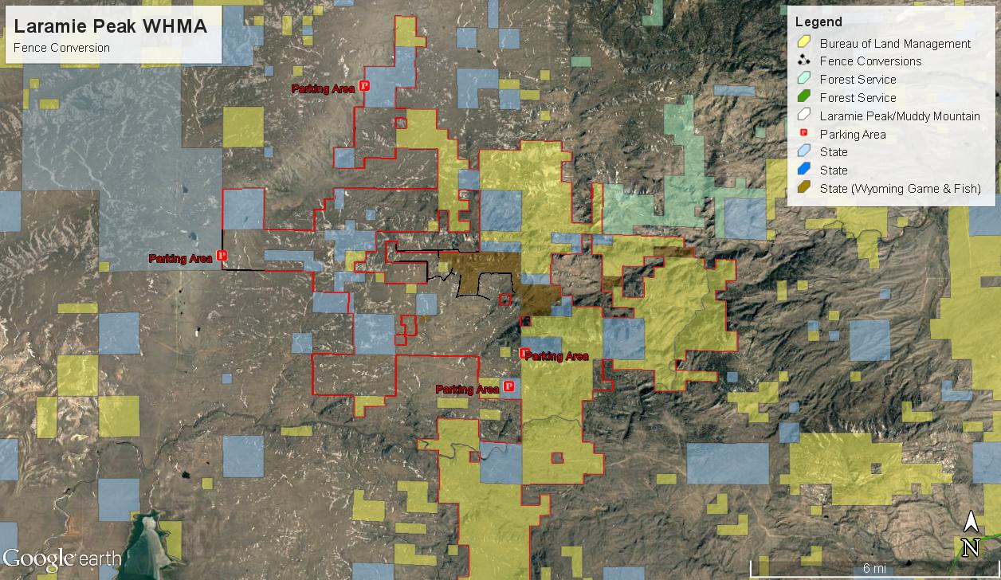

Slide 8
Laramie Peak WHMA Fence conversion
This project is to replace ten miles of dilapidated woven wire and five strand barb wire fence to a wildlife friendly standard.
New fence will be all metal post and four wire with top wire no higher than 42” and bottom smooth wire no less than 16”.
New fence will be moved to locations away from snow drifts and strategically placed for big game movements.
New fence will have large wire gates installed in locations with high wildlife crossings and be left open when no livestock are in neighboring pastures.

Slide 10
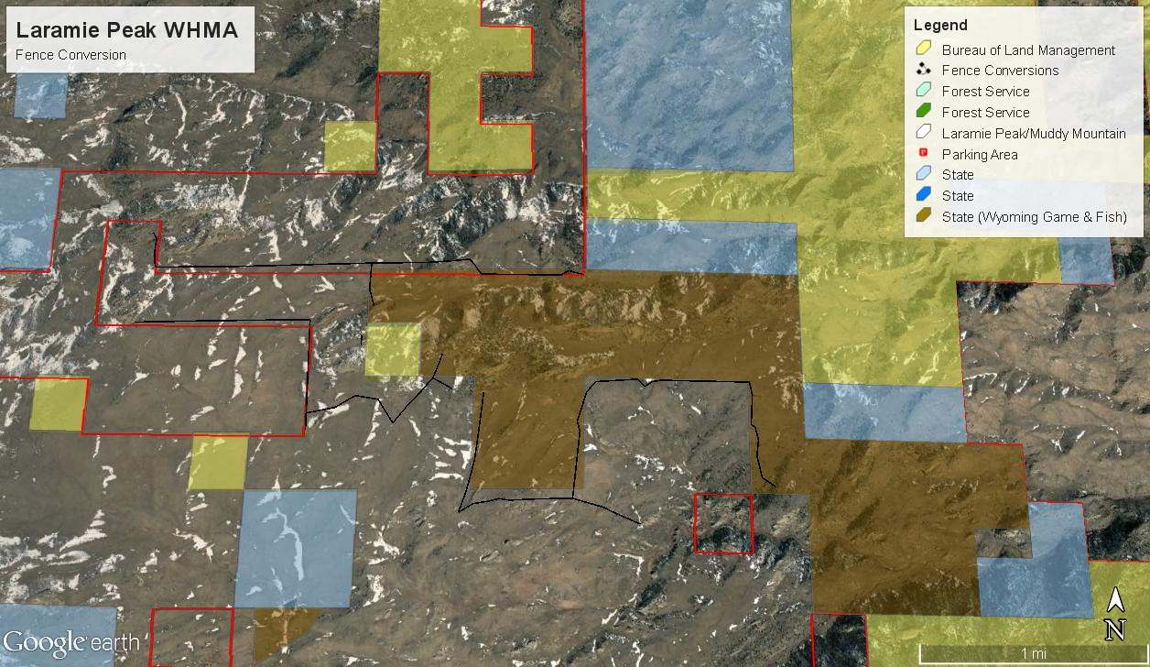

Slide 11
Questions?

